Slide 1



CHALLENGES OF ARTIFICIAL INTELLIGENCE: SECURITY, ETHICS AND LAW.
THE CASE OF THE LETHAL AUTONOMOUS SYSTEMS
Dr. Joaquín Rodríguez Álvarez

Slide 2
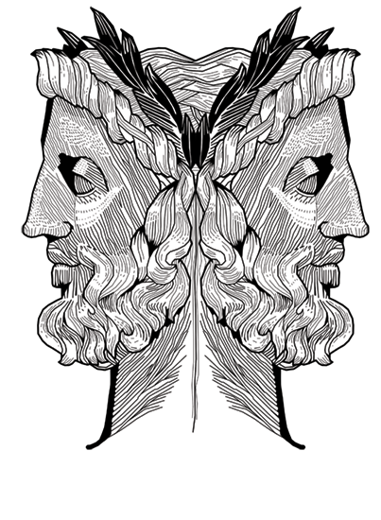
CONTEXT

Slide 3

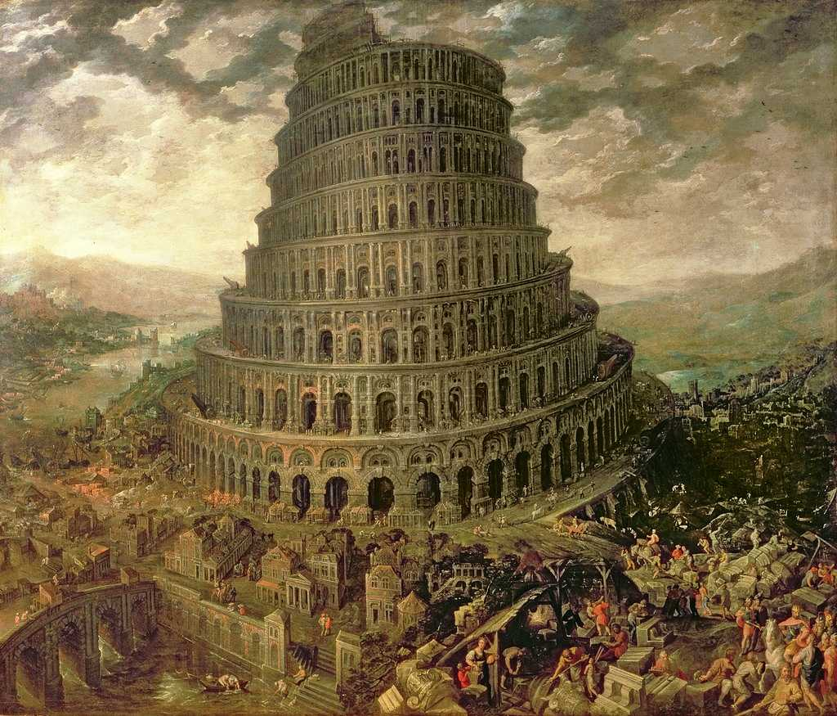
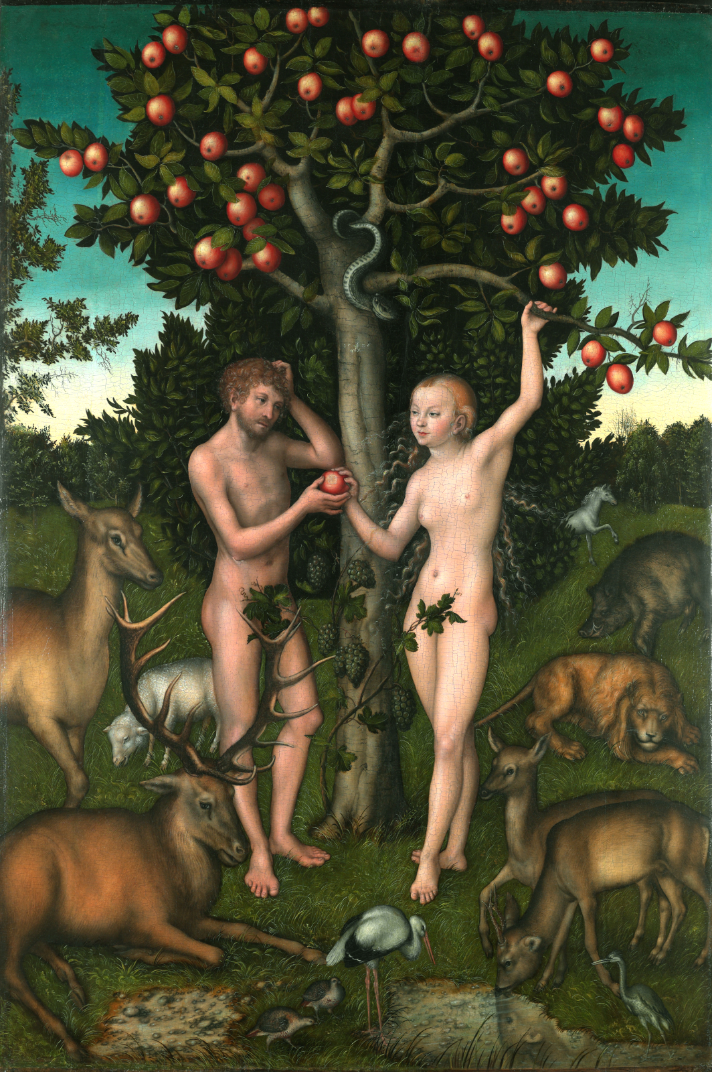
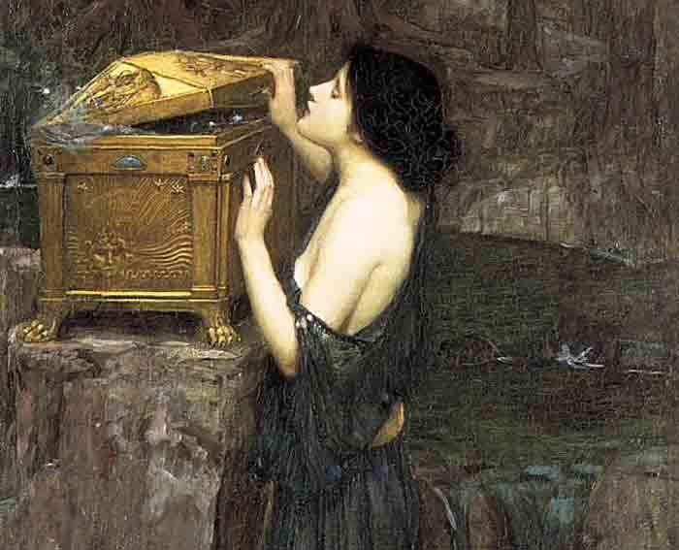
FROM LEFT TO RIGHT, PROMETHEUS, TOWER OF BABEL, ADAM AND EVE, PANDORA’S BOX.

Slide 4
“”
Technology it’s just an amplifier of Human Will
Kentaro Toyama

Slide 5
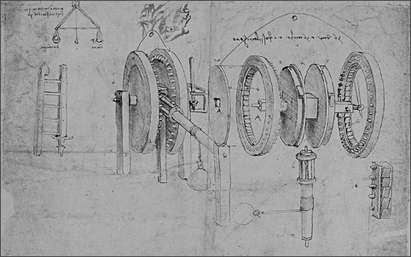
TECHNOLOGY POWER AND LAW

Slide 6

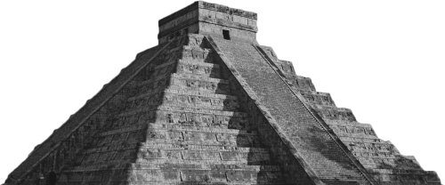

Slide 7
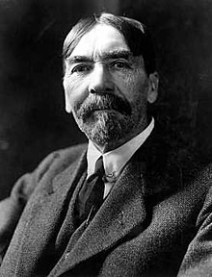
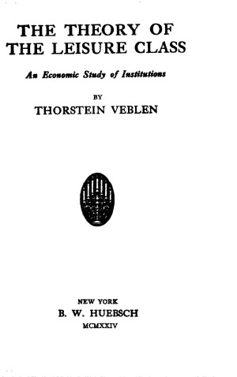

Slide 8
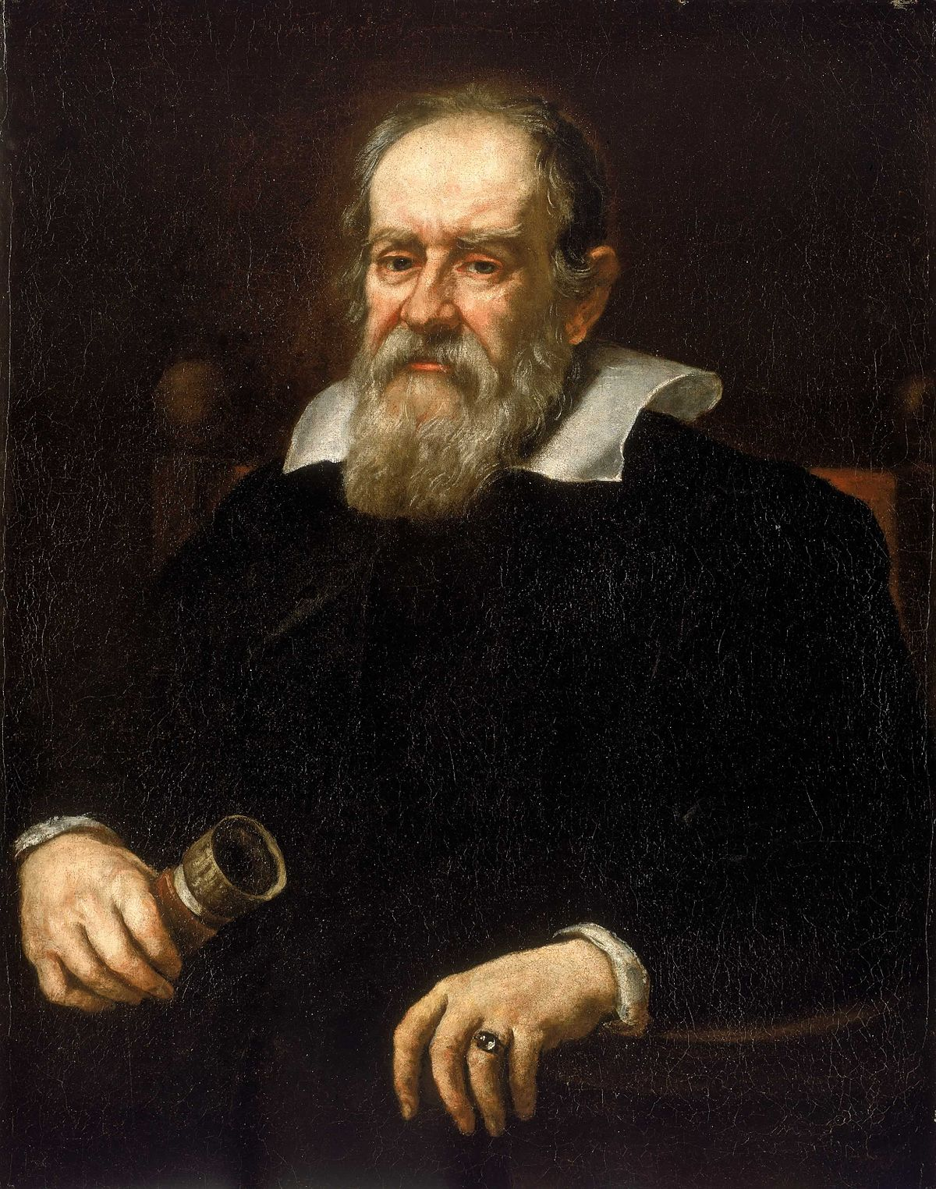
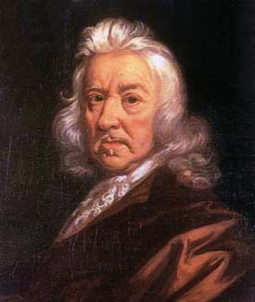
GALILEO GALILEI
THOMAS HOBBES

Slide 9


REGULATING TECHNOLOGY
Disconnection between science and law
Science offer probabilities not certainties to value-landen questions
Cultural Delay in relation with technological achievements and product generation

Slide 10
TYPES OF INTERNET CRIME
Cyberbullying and harassment
Financial extortion
Internet bomb threats
Classified global security data theft
Password trafficking
Enterprise trade secret theft
Personally data hacking
Copyright violations, such as software piracy
Counterfeit trademarks
Illegal weapon trafficking
Online child pornography
Credit card theft and fraud
Email phishing
Domain name hijacking
Virus spreading

Slide 11

ARTIFICIAL INTELLIGENCE

Slide 12
“”
The crisis consists precisely in the fact that the old is dying and the new cannot be born; in this interregnum a great variety of morbid symptoms appear.
A. Gramsci

Slide 13
AI AUTONOMY
A robot may not injure a human being or, through inaction, allow a human being to come to harm.
A robot must obey orders given it by human beings except where such orders would conflict with the First Law.
A robot must protect its own existence as long as such protection does not conflict with the First or Second Law.

Slide 14
AI AUTONOMY
Loans
University Application
Law enforcement
Judiciary
Credit Scoring
Social Scoring
Information
Newsfeeds

Slide 15

MEANINGFUL HUMAN CONTROL

Slide 16
MYSTIFICATION
Humanization
Efficiency
Reliability

Slide 17
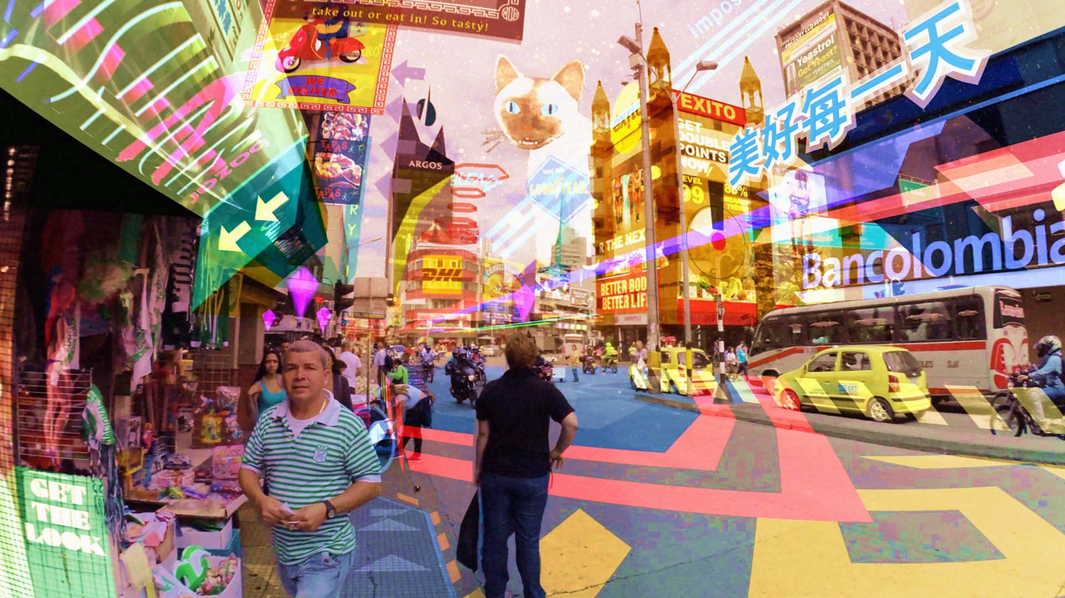
HYPERREALITY

Slide 18
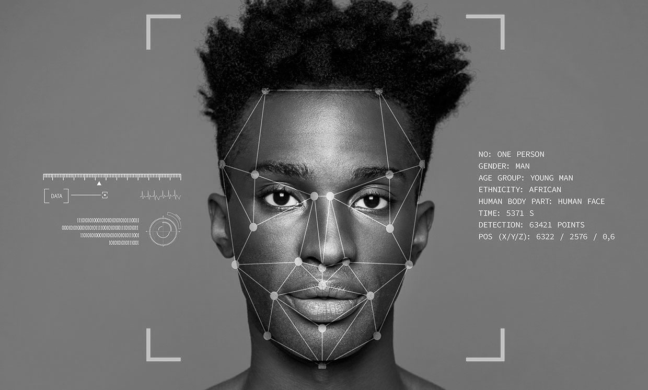
RELIABILITY
ACLU
Big Brother Watch
Gender, Race

Slide 19

ETHICS

Slide 20
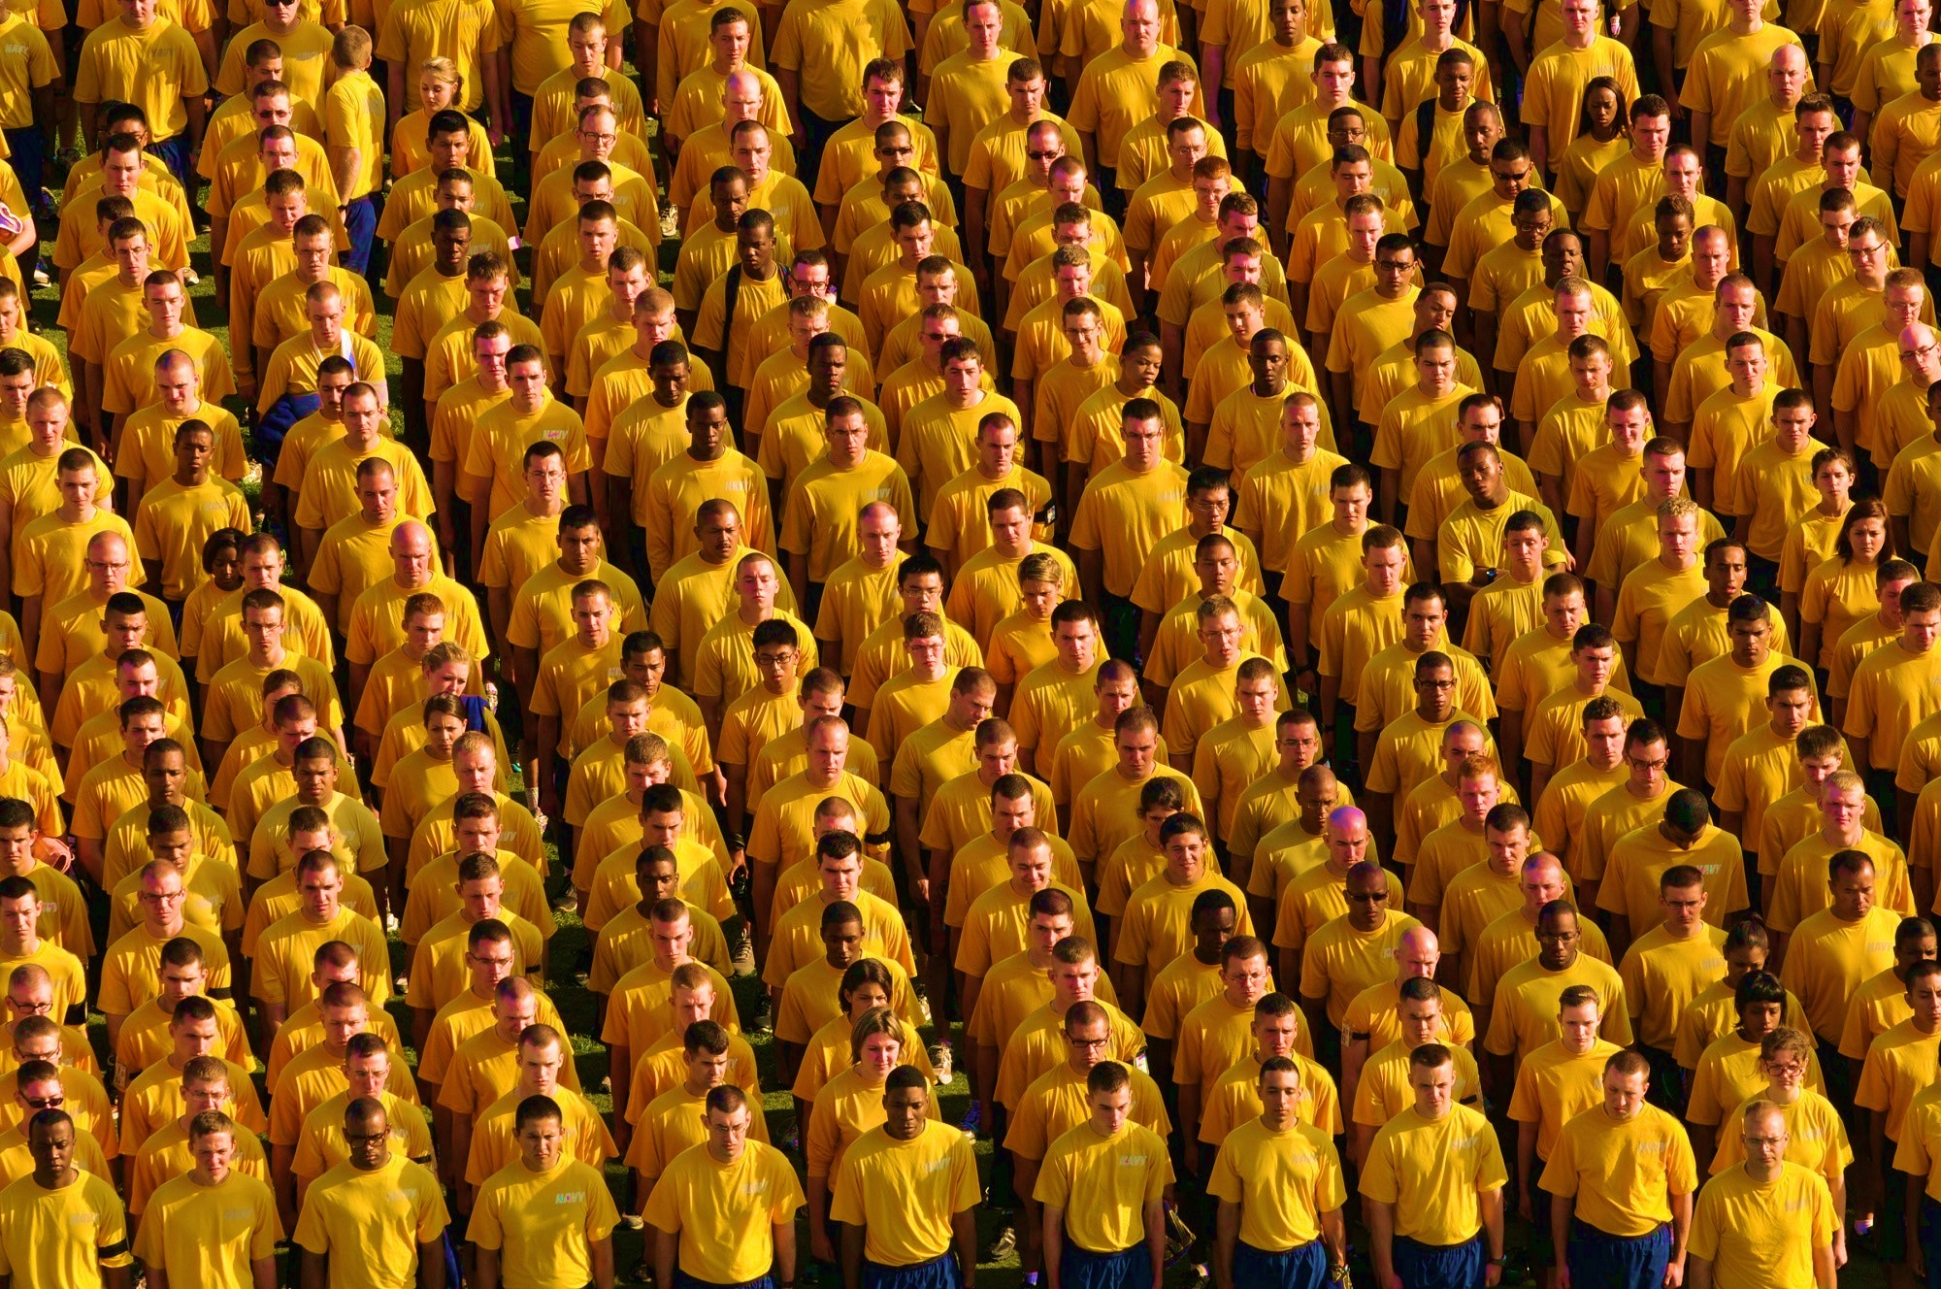
AUTOMATION BIAS

Slide 21
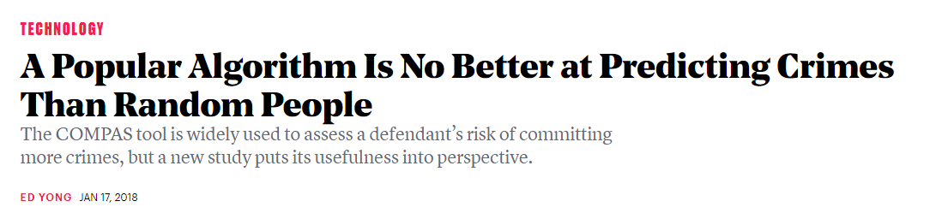
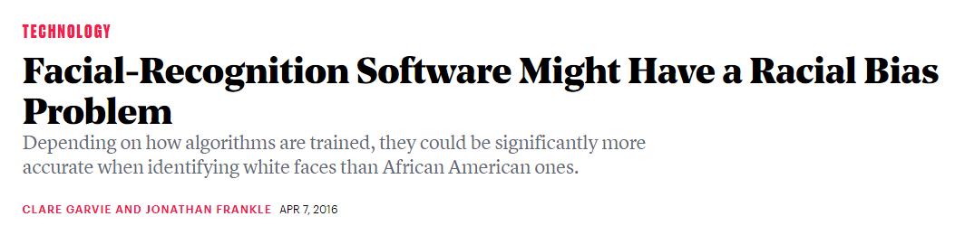

Slide 22
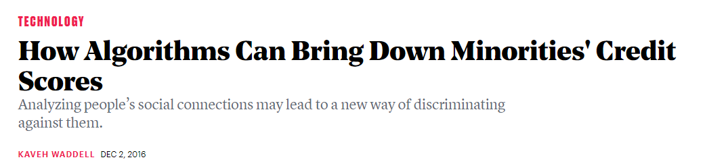
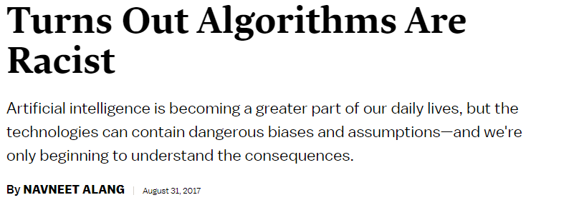

Slide 23
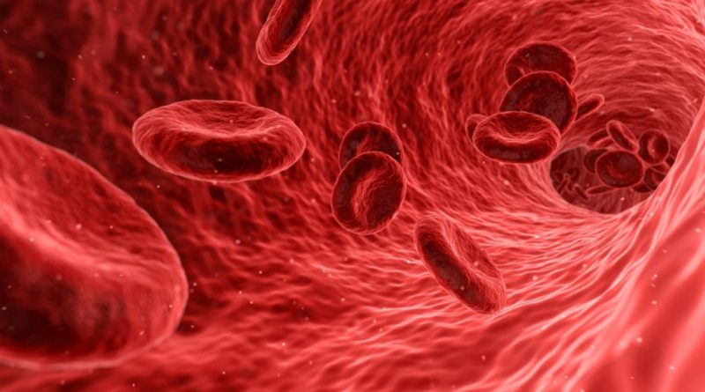
DATA

Slide 24
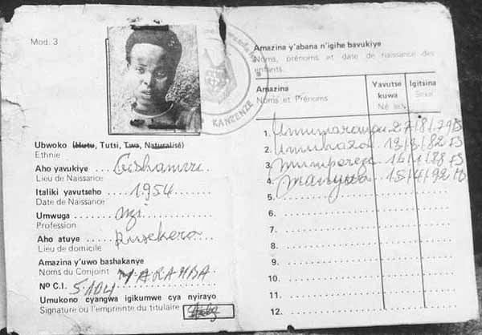
RWANDA

Slide 25
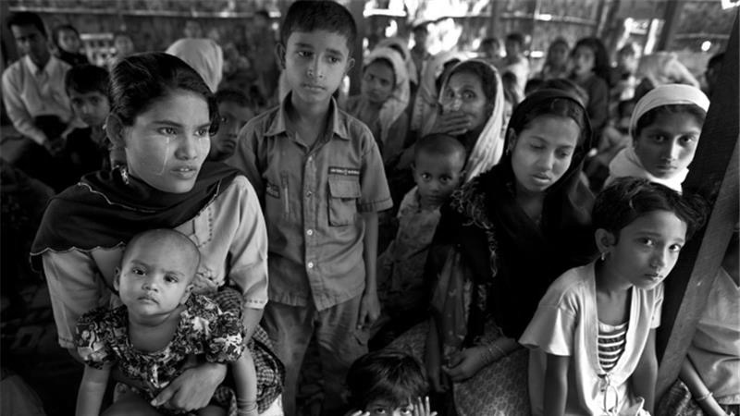
BANGLADESH

Slide 26
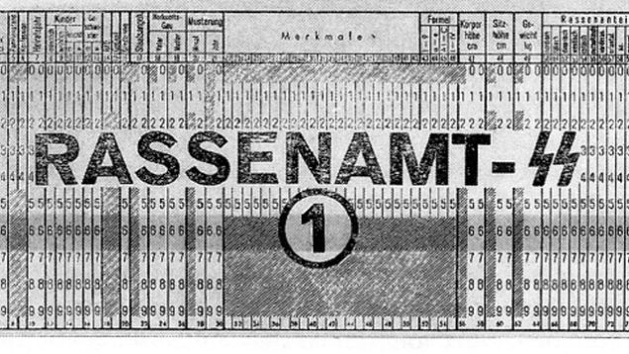
HOLOCAUST

Slide 27
We live in a society where there is more and more information and less and less meaning
“”
Jean Baudrillard

Slide 28
LAW
Outer Space Treaty 1967
Moon treaty 1984
Universal declartion of Bioethics 2005
Data Protection (EU)

Slide 29


Slide 30
SECURITY
LAWS
LETHAL AUTONOMOUS WEAPON SYSTEMS

Slide 31
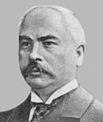
MARTENS CLAUSE
“”
Until a more complete code of the laws of war is issued, the High Contracting Parties think it right to declare that in cases not included in the Regulations adopted by them, populations and belligerents remain under the protection and empire of the principles of international law, as they result from the usages established between civilized nations, from the laws of humanity and the requirements of the public conscience.
Convention with respect to the laws of war on land (Hague II), 29 July 1899

Slide 32

HUMAN DIGNITY

Slide 33
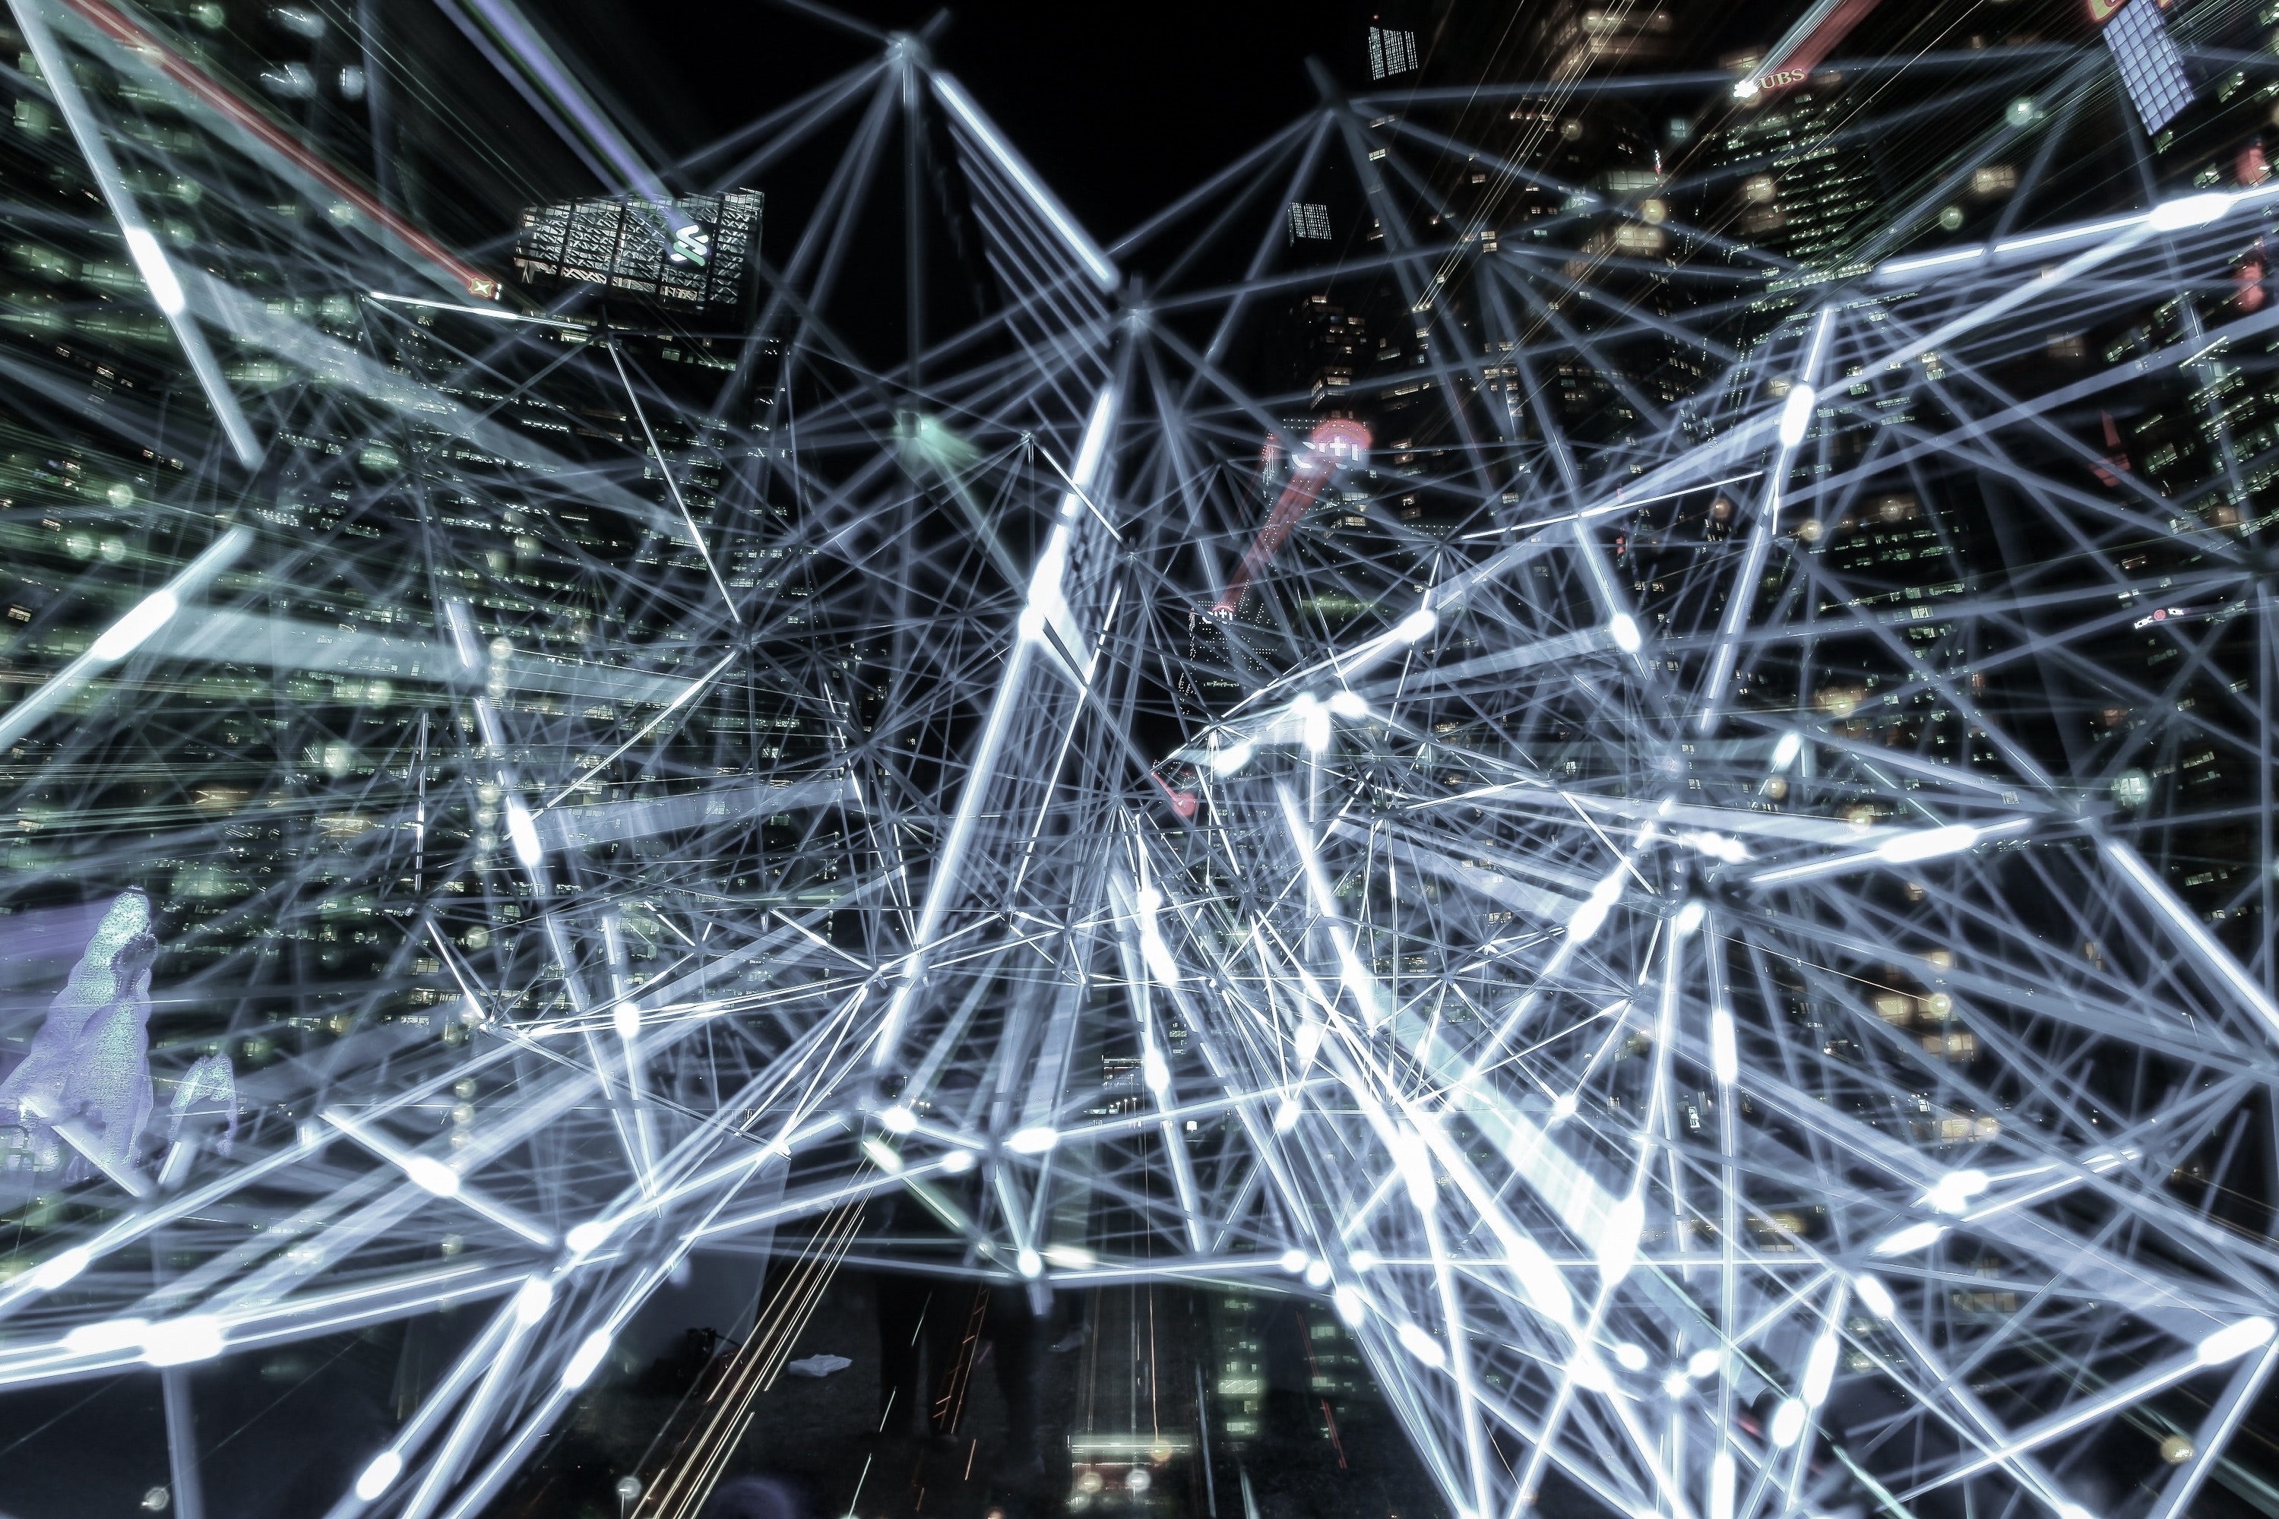
BLOCK CHAIN

Slide 34
One of the major characteristics of Block chain is the immutability of the blocs once built thanks to its distribution through millions of nodes. Meaning that we are talking about a data structure in which the information contained is grouped into blocks to which meta-information is added relative to another block of the previous chain in a time line, so thanks to cryptographic techniques, the information contained in a block can only be repudiated or edited by modifying all subsequent blocks.

Slide 35


Slide 36
“”
Where there is power, there is resistance.
Michel Foucault, The History of Sexuality, Volume 1: An Introduction

Slide 37
CONCLUSIONS
Clearly define the concept of Meaningful Human Control
Clearly stablish the cases where MHC should be requiered
Understand Administrative Law as our best tool to adress technological progress
Revisited the concept of human dignity in the context where non-human intelligences affects human lifes
Create Agencies for AI Assestment

Slide 38
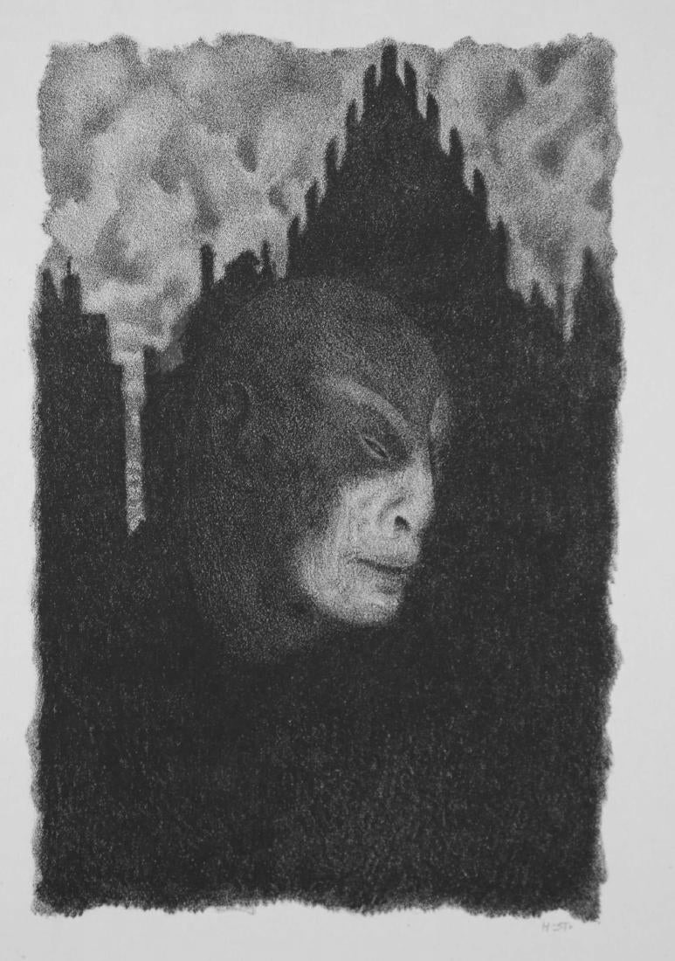
Truth = אמת
Death = את

Slide 39
The secret of theory is that truth does not exist.
“”
Jean Baudrillard

